Slide 1

NI
Lecture
Networking Infrastructure
Routing Protocols
3
Networking Infrastructure
Diploma in CSF / IT
Year 2 (April 2022), Semester 3
Notes:
Left-hand Bar – Replace FSP by your module code and X by the lecture number.
Replace Lecture Title
Replace < Module Name >
Replace Year and Semester if necessary

Slide 2
Routing In A Network
Objectives
Recap the functions and benefits of routers
Describe static routing
Understand the concept of Static routing
Ability to configure Static routing
Notes:
https://www.routeralley.com/guides/static_dynamic_routing.pdf

Slide 3
Functions Of A Router - Recap
A router is a multi-port internetworking device that interconnects two or more networks. It performs “forwarding and filtering” of data packets between these networks at the network layer.
A router makes decisions based on the destination IP address of a packet unlike a switch that uses a MAC address in a data frame to perform switching.
A router routes packets from one network to another network until it reaches its destination based on the destination IP address.
Notes:
A switch performs “forwarding and filtering” of data frames between LAN segments at the Data Link (MAC) layer.

Slide 4


Functions Of A Router - Recap
Routing Table
Network Address | Outgoing Interface
153.20.0.0 | P1
192.168.1.0 | P2
210.1.1.0 | P3
R1
153.20.0.1
P1
P3
210.1.1.1
153.20.0.0
P2
192.168.1.1
210.1.1.0
192.168.1.0
Switch 1
Switch 2
Switch 3
153.20.0.2
255.255.0.0
153.20.0.3
255.255.0.0
153.20.0.4
255.255.0.0
192.168.1.2
255.255.255.0
192.168.1.3
255.255.255.0
192.168.1.4
255.255.255.0
210.1.1.2
255.255.255.0
210.1.1.3
255.255.255.0
210.1.1.4
255.255.255.0
Notes:
Outgoing Interface on Cisco Router: G0/0, G0/1 (or Fa0/0, FA0/1)

Slide 5
Network ID - Recap
The router is connected to three networks. The networks IDs are 153.20.0.0, 192.168.1.0 and 210.1.1.0 respectively.
Each network device needs to be configured with IP address and subnet mask
IP address has two components: network and host.
Subnet mask extracts the network component from an IP address
For example, a PC with IP address 192.168.1.1 and subnet mask 255.255.255.0, the Network ID is 192.168.1.0
A router keeps track of Network IDs and not every individual IP address.
Notes:
IP address has two components network and host
Subnet mask is used to identify the network component of the ip address
Routers keep track of network IDs in their routing table and not individual ip addresses.

Slide 6
Benefits Of A Router
Separates network logically into subnets; reduces network traffic as packets are only routed to their destination subnet
Isolates MAC broadcasts as it does not forward broadcast frames.
Connects different protocols: LAN protocols (e.g. Ethernet MAC) and WAN protocols (e.g. PPP).
Notes:
Separate network into subnets. Reduces traffic as packets are only routed to their destination subnet. Also saves IP addresses
Connects different protocols LAN and WAN
Isolates MAC broadcast as it does not forward broadcast frames https://networkengineering.stackexchange.com/questions/14694/how-does-router-prevent-broadcast-radiation

Slide 7


Routing in Action - Recap
NW 3: 200.30.10.0
NW 2: 75.0.0.0
R1
NW 1: 153.20.0.0
NW 4: 133.33.0.0
153.20.88.99
133.33.3.3
NW 5: 222.20.2.0
Notes:
Refer to OSNF Lecture on IP Addressing & Routing.

Slide 8
Activity – Functions & Benefits of Routers
Complete Tutorial
Activity 1, Q1 to Q5
Activity 2, Q1 to Q4

Slide 9
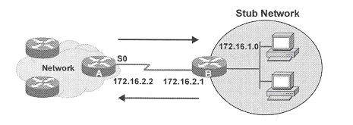
Static Routing
Static routes are entries in the routing table of the router that are manually configured (user-defined fixed path entries)
Administrator must know the entire network and manually configure all routes if all routes are static
Useful in a stub network (a network that is only accessible by one path)
Image source: http://i.stack.imgur.com/7wphw.gif access on 27 Sep 2016
Notes:
Static Routes are manually configured
Hence administrator must know the entire network if he wants to configure all routes using static routing
Useful in a stub network (network that is only accessible by one path)

Slide 10
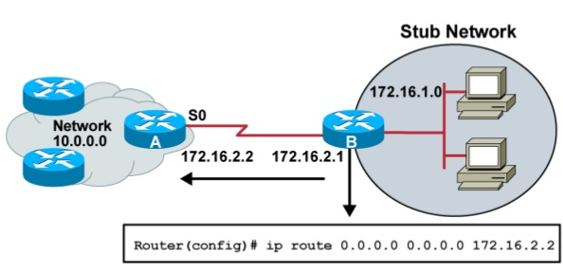
Static Routing – Stub Network
http://image.slidesharecdn.com/day81introducingrouting-150514063503-lva1-app6892/95/day-8-1-introducing-routing-9-638.jpg?cb=1431587930
Notes:
A stub network is a computer network, or part of an internetwork that send all of its non-local traffic out via a single path, with the network aware only of a default route to non-local destinations.
Since the stub network is connected to a single path to the rest of the internet, the router of the stub network can only send to one router, so it does not need to know any other route information. So a static route pointing to the default route is the most efficient way to configure the router.

Slide 11
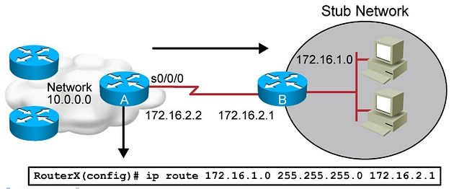
Static Routing – Stub Network
http://http://www.learncisco.net/assets/images/icnd1/91-static-route-example.jpg

Slide 12
Benefits of Static Routing
Enhance Security
Administrator might want to hide parts of an internetwork and specify only those parts that need to be revealed; dynamic routing tends to reveal everything known of an internetwork
Static route force traffic to take a specific, secure route instead of a route determined dynamically which can change as the network topology changes making traffic travel over an insecure route
Does not consume much traffic as no routing updates are transmitted
Notes:
Admin might want to hide parts of the internetwork however dynamic routing tends to reveal all information of the network. Static routing is able to hide parts of the internetwork.
As the network topology changes, the routes used for dynamic routing can change. And the data might travel a route that is insecure. Static routing forces packets to travel a specific secure route no matter what.
Does not consume much traffic as not routing updates are required

Slide 13
Bad thing about Static Routes
Not suitable for large networks as administrator must know the entire network and manually configure all routes if all routes are static
Any change to the network means re-configuring all routers to reflect the change
Not be able to re-route the traffic if a link fails
Notes:
Administrator must manually configure all routes and if the network is large he would have to know the entire network. Thus not suitable for large networks. Also, if there are changes in the network, all routers will have to be manually reconfigured to reflect the changes. Lastly, static routing cannot re-route the traffic if a link fails

Slide 14
Activity – Concepts of Static Routing
Complete Tutorial
Activity 1, Q6 to Q9
Activity 3, Q1

Slide 15
Static Route Operation
Three-part sequence
Network administrator configures the route in the router
The router installs the route in its routing table
Packets are forwarded based on the static route entries in the routing table
Notes:
The admin first configures the static route. After the static route will be updated in the router’s routing table. Packets are forwarded based on the static route entries in the routing table.

Slide 16
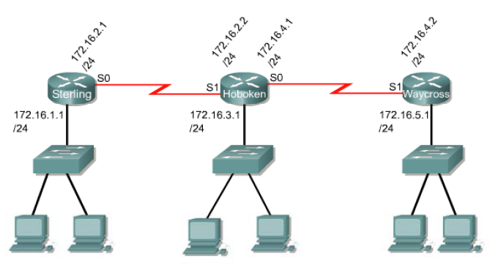
Static Routing

Slide 17
IP Route Command
There are two ways to define a static route using the “ip route” command
Specifying the outgoing interface for the packet
Only possible for Point-to-Point connections
Specifying the Next Hop IP address for the packet
Works for all types of connections

Slide 18
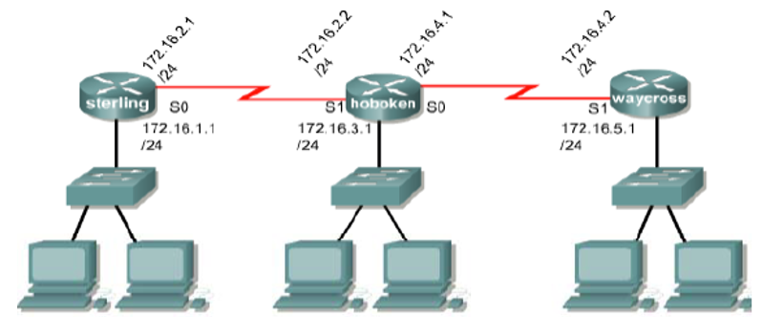
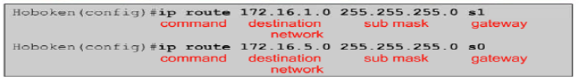
Specifying Outgoing Interface
Notes:
Ip route 172.16.1.0 255.255.255.0 s1
Ip route 172.16.5.0 255.255.255.0 s0

Slide 19
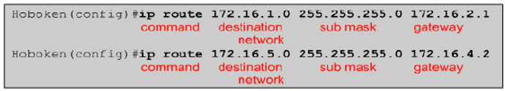
Specifying Next-Hop Address
Notes:
Ip route 172.16.1.0 255.255.255.0 172.16.2.1
Ip route 172.16.5.0 255.255.255.0 172.16.4.2

Slide 20
Example
What is the command to set up a static route on router “sterling” for the 172.16.5.0 network on the Ethernet LAN of router “waycross”?
Sterling(config)#ip route 172.16.5.0 255.255.255.0 172.16.2.2
Destination Network
Next-hop address
Subnet mask
Notes:
Ip route 172.16.5.0 255.255.255.0 172.16.2.2/S0

Slide 21

Default Route
A default route is a special static route that uses this format:
Default routes are used to route packets with destinations that do not match any of the other routes in the routing table.
Routers are typically configured with a default route for Internet-bound traffic since it is often impractical and unnecessary to maintain routes to all networks in the Internet.
Only one route out
Notes:
Default route - also known as the gateway of last resort, is the network route used by a router when no other known route exists for a given IP packet's destination address. All the packets for destinations not known by the router's routing table are sent to the default route.
Ip route 0.0.0.0 0.0.0.0 [next hop address | outing interface]
Ip route 0.0.0.0 0.0.0.0 172.16.2.2

Slide 22
Verifying Static Route Configuration
The command show running-config is used to view the active configuration in RAM to verify that the static route was entered correctly.
The show ip route command is used to make sure that the static route is present in the routing table
Notes:
Show ip route shows the routing table

Slide 23
The show ip route Command
sterling#sh ip route
Codes: C - connected, S - static, I - IGRP, R - RIP, M - mobile, B - BGP
D - EIGRP, EX - EIGRP external, O - OSPF, IA - OSPF inter area
N1 - OSPF NSSA external type 1, N2 - OSPF NSSA external type 2
E1 - OSPF external type 1, E2 - OSPF external type 2, E - EGP
i - IS-IS, L1 - IS-IS level-1, L2 - IS-IS level-2, ia - IS-IS inter area
* - candidate default, U - per-user static route, o - ODR
P - periodic downloaded static route
Gateway of last resort is not set
S 172.16.5.0/24 [1/0] via 172.16.2.2
C 172.16.1.0/24 is directly connected, FastEthernet0/0
C 172.16.2.0/24 is directly connected, Serial2/0
Note: Administrative Distance is just a number (0 to 255) set by Cisco to indicate the reliability of the route (0 is most reliable). For static route, the default admin distance is 1. Metric for static route is always 0 because the next hop router is 0 hop away.
Administrative Distance/Metric
S 172.16.5.0/24 [1/0] via 172.16.2.2
Destination Network
Next Hop Address

Slide 24
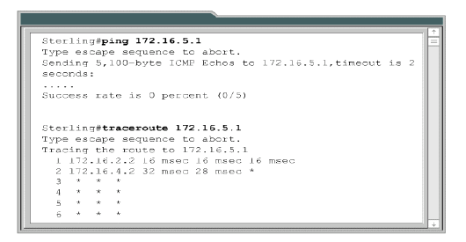
The traceroute command
Diagnostic tool for displaying the route (path) and measuring transit delays of packets across an Internet Protocol (IP) network.
The packet is able to reach 172.16.4.2 but gets no response after that. Possible causes include:
The destination’s firewall or other security device is blocking the request.
There could be a problem on the return path from the target system..
Notes:
The destination’s firewall or other security device is blocking the request. •There could be a problem on the return path from the target system. Remember the round trip time measures the time it takes for a packet to travel from your system to a destination system and back. The forward route and the return route often follow different paths. If there is a problem on the return route, it may not be evident in the command output. •There may be a connection problem at that particular system or the next system.

Slide 25
Routing In The IP Environment
Summary
Static routes are manually configured routes
Good for small networks, not good for large networks
Good for security
Notes:
https://www.routeralley.com/guides/static_dynamic_routing.pdf
Bad for large networks
Good for small
Enhanced security
Manually configured

Slide 26
Activity – Concepts of Static Routing
Complete
Practical
Tutorial Activity 3, Q2

